Slide 1
Emerald Peer Evaluation Tool
Ben Dollenmayer, Zach Salem, Julia Kolnicki

Slide 2
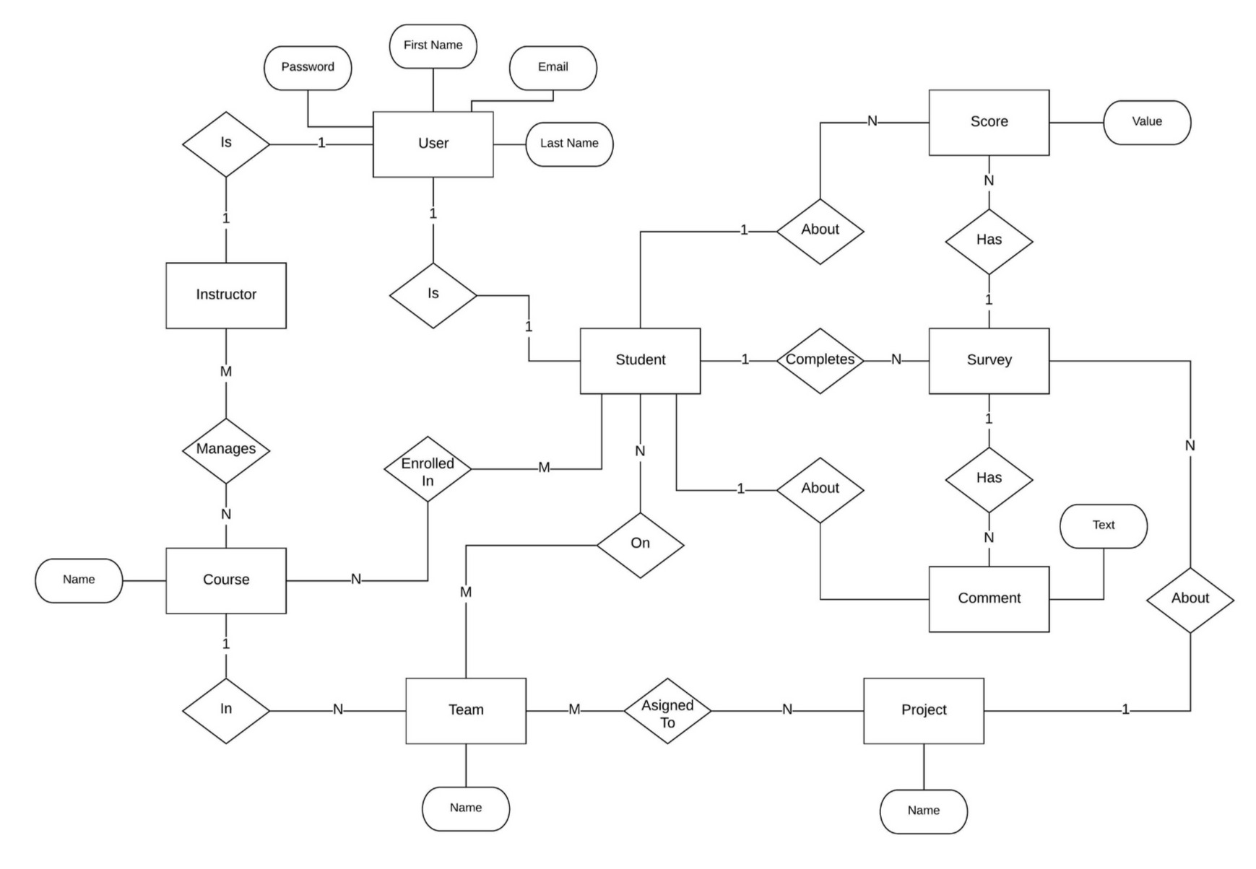
Models

Slide 3
Controllers
Application:
Checks if the signed in user is an instructor and whether or not they have selected a course.
Home:
Responsible for rendering the homepage depending on an instructor vs. student, and also lets the instructor add new courses
Student:
Allows an instructor to create students from their own roster and add them to the currently selected course
Team:
Gets all of the students in the current course and allows an instructor to create a team and add the selected students to that team.
Project:
Renders all of the teams and allows an instructor to create a new project and add teams to it
Survey:
Renders a particular student’s teammates and creates surveys that are filled out by the signed in student
Stat:
Responsible for rendering the statistics for each student’s survey and gives the instructor an overall view of the team’s performance

Slide 4
Client Demo
Let’s do a walkthrough of our app!

